Slide 1

Principles of Web Programing 17CSCI03P
Now You See Review
Web Design Project
Dr. Essam Rashed
BUE ICS Year Prep
ID | STUDENT NAME
177619 | Tarek Mohammed Mukhtar
170907 | Youssef Hesham Mohamed
178244 | Mohamed Hany Abdelwahed
170009 | Mohamed Kamel Hussein
155167 | Mohamed Hesham Mohamed

Slide 2
Agenda
Website’ title and main idea.
Website’ objectives and main goals.
Website’s target audience.
Website’ Organization through sitemap.
Website’ Design and Layout through wireframes.
Challenges.
Conclusion.
Questions.

Slide 3
The idea of the webpage
Website Title
Now You See Review
The idea of our site (now you see review) is to provide a quick summarized review in an organized way to different products.

Slide 4
The objectivity of the webpage
The website aims to assist the user to choose the top products in 2017 and 2018 and settle on the right choice by only a click of a button. Not only by providing him reviews from different experienced customers, but also different types of products, as well as, this website will accomplish the user by providing him with the right reviews and also the flexibility of choosing a review of different products he likes. Now You See Review is the only site which provides the user to review books, movies and technology in one web site.

Slide 5
Audience
It is accessible for everyone regardless of his age, gender and interest because this website adds all the type of products.

Slide 6
Website’ Organization
Home
Mobile
Cars
Consoles
Movies
Samsung A8
Samsung S9
Ferrari Spider
Audi A8
Books
Drama
Action
Romance
PlayStation 4
Xbox One
Action
Comedy
iPhone 8
Toyota 4Runner
Thriller

Slide 7
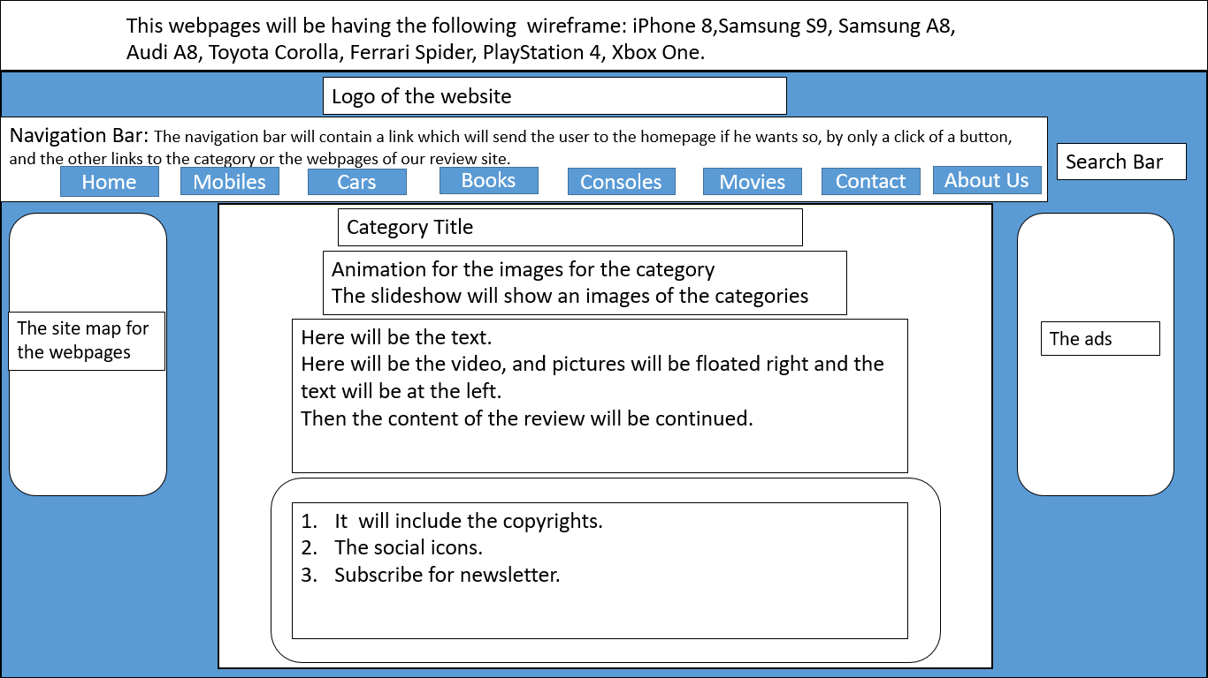
Design

Slide 8
Challenges
Making the page responsive

Slide 9
Conclusions
Finally, we reached our aim to create a website which contains a different products to review

Slide 10

Questions

